Slide 1
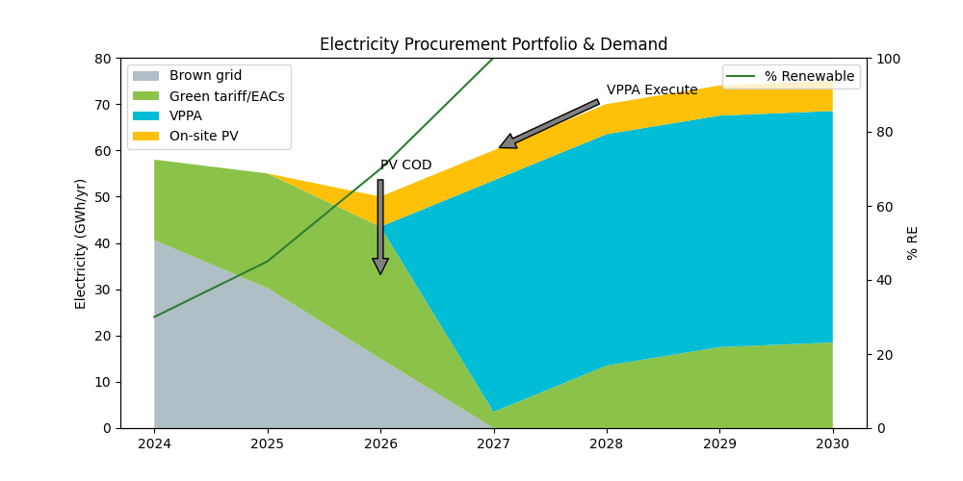

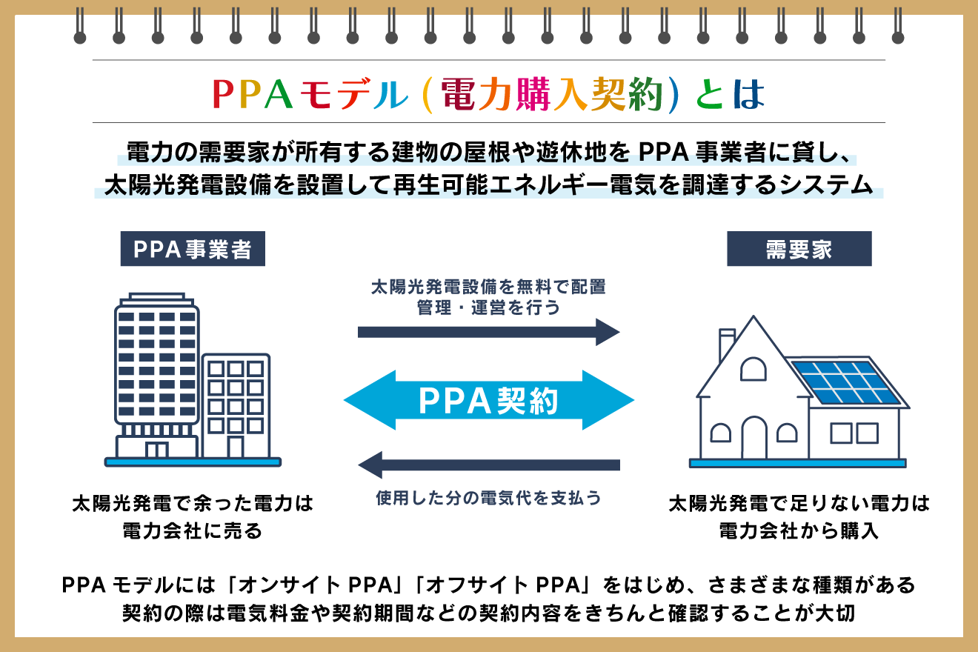
100% Renewable Electricity: PPAs + On-site
Electricity demand GWh by year:
2024: 58
2025: 55
2026: 50
2027: 60
2028: 70
2029: 74
2030: 75
On-site PV: 5 MWdc rooftop/ground-mount, ~6.5 GWh/yr from 2026; 2 MWh/1 MW battery for peak shaving
VPPA: 50 GWh/yr solar/wind VPPA from 2027; tenor 10 years; hub-settled, Baseload-shaped
Green tariff EACs: Top-up to 100% from 2027 (3.5–18.5 GWh/yr); 30–70% prior to VPPA start

